Slide 1
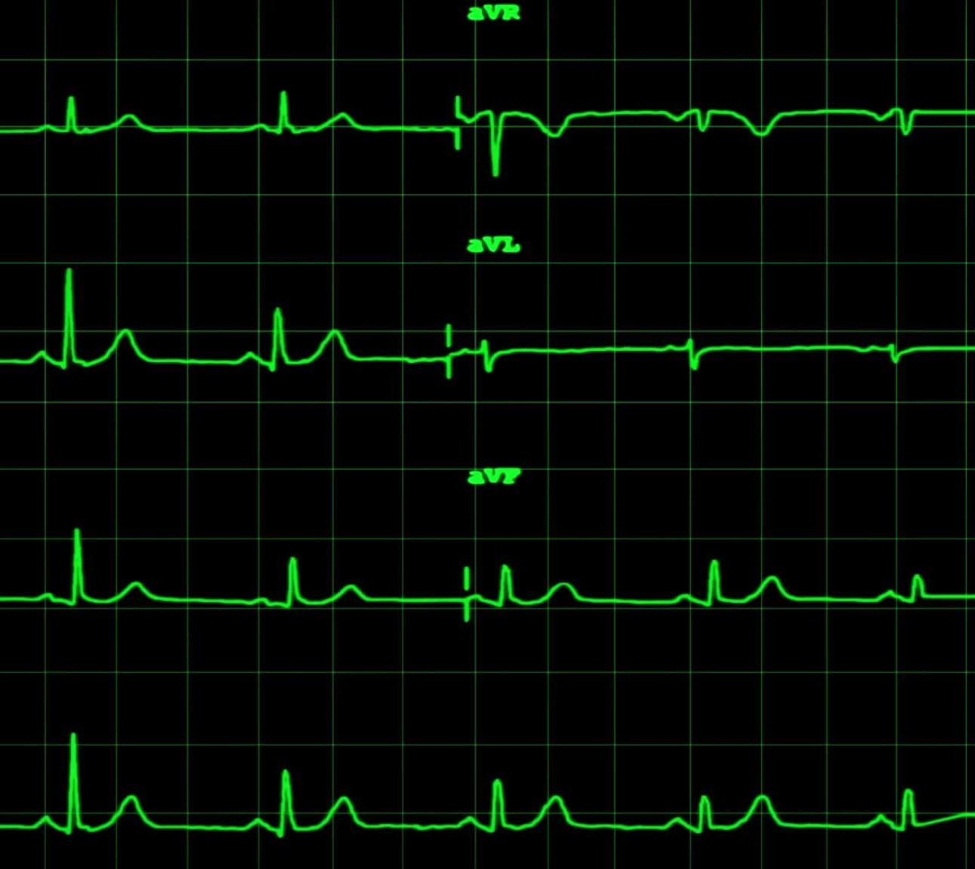
Heart Rate Finder
First-year Hardware Project
School of ICT
Metropolia University of Applied Sciences 2024
Presented By: Usha Gautam
Nilesh Sah
Vibek Rokaya

Slide 2
Agenda
Introduction
Objectives
Project Goal
Methodology
Conclusion

Slide 3

"Heart Rate Finder" Project aims is to develop a mechanism for accurately measuring heart rates using wearable sensors, mobile apps, or medical equipment.
Key Objectives:
Create a user-friendly interface.
Ensure accurate and consistent heart rate readings.
Integrate activity tracking and personalized health insights.
Project Goals:
Meet demand for convenient heart rate monitoring.
Empower individuals in managing health and fitness.
Promote wellness with precise heart rate monitoring.

Slide 4
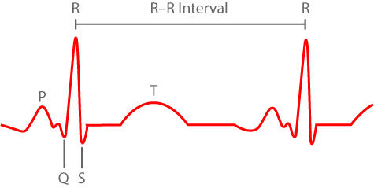
Materials Used: Technical Features
Heart Rate Explorer Device(HRE) Raspberry Pi for data processing Customized Sensor for minute change in heat beat intervals. Cables Software(Thony) with Advance User Interface
Factors Influencing HR and HRV:
Age, fitness level, and stress influence HR.
HRV is linked to autonomic nervous system activity, emotional regulation, and cardiovascular function.
Higher HRV often signifies better cardiovascular health and stress resilience.
This Photo by Unknown author is licensed under CC BY-SA-NC.

Slide 5
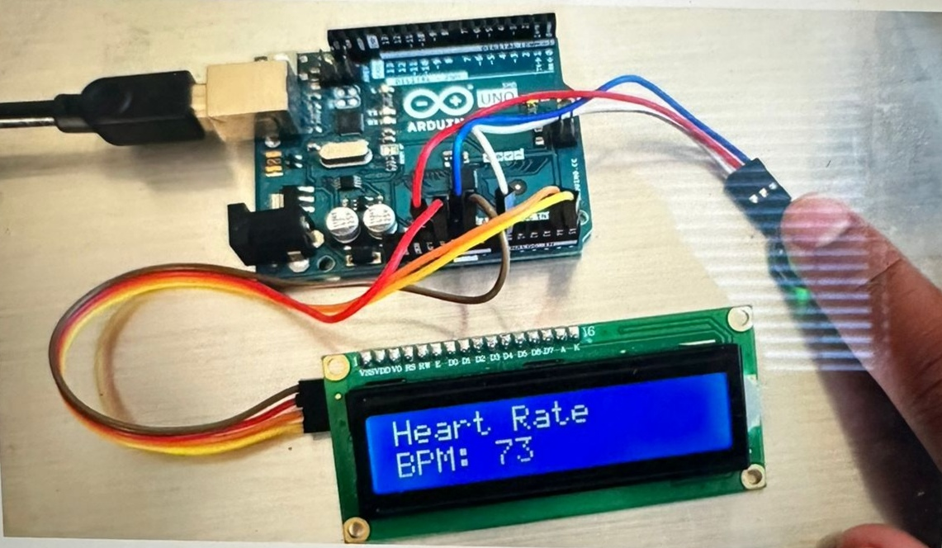
Normal Range and Variability:
Resting HR typically falls between 60 to 100 bpm, with lower rates indicating superior fitness.
Sensor Technology:
Pulse Sensor: Sensor typically includes an infrared LED and a photodetector. The LED shines light into the skin, and the photodetector measures the amount of light that is either absorbed or reflected by the blood vessels. As blood pulses through the vessels, the amount of light absorbed or reflected changes.
Screen: The screen in our project is an OLED display. This display shows text, numbers, images, or graphical content that display to the user. We need to write code to update the screen with the current heart rate measured by the pulse sensor.
OLED Display: OLED displays are lightweight, thin, and consume less power compared to traditional LCD displays. They are also capable of displaying bright, vivid colors and have faster response times. We need to connect the OLED display to the Raspberry Pi and we need to write code to update it with the current heart rate.

Slide 6
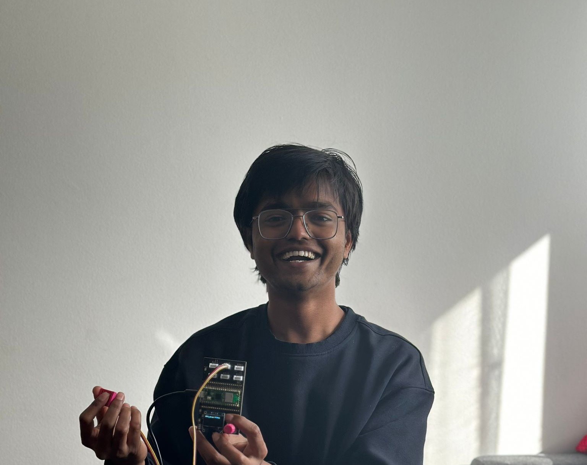
Methodology:
Conducted HRV operation as per user manual instructions.
Customized sensor design for minute interval changes detection.
Real-time monitoring of maximum, mean, and minimum values.
Results:
Smooth project execution without technical issues.
Validated system for accurate data collection.
Identified early heart rate malfunction indications.
Conclusion:
Successful utilization of HRE device for heart health assessment.
Reliable measurement of cardiovascular parameters achieved.
Potential for early detection of heart rate abnormalities demonstrated.

Slide 7
Basic Alogrithm
Initialization Initialize components. Set up network and authentication.
Display Welcome Message Show welcome message.
Wait for User Input Display "press to start" message. Wait for input.
Start Data Collection Begin data collection. Initialize data management.

Slide 8
Basic Alogrithm
Display Data on OLED Process and display data.
Peak Detection and Heart Rate Calculation Detect peaks. Calculate heart rate and metrics.
Kubios Integration and Analysis Connect to Kubios. Send data for analysis. Handle response.
Display Results and User Interaction Show analysis results. Handle user interaction and mode switching.

Slide 9
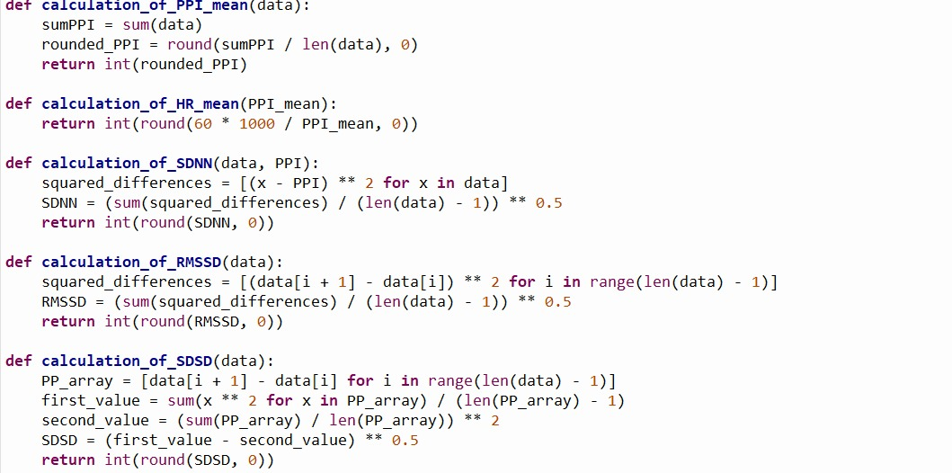
This is the basic principle of the system of code.

Slide 10
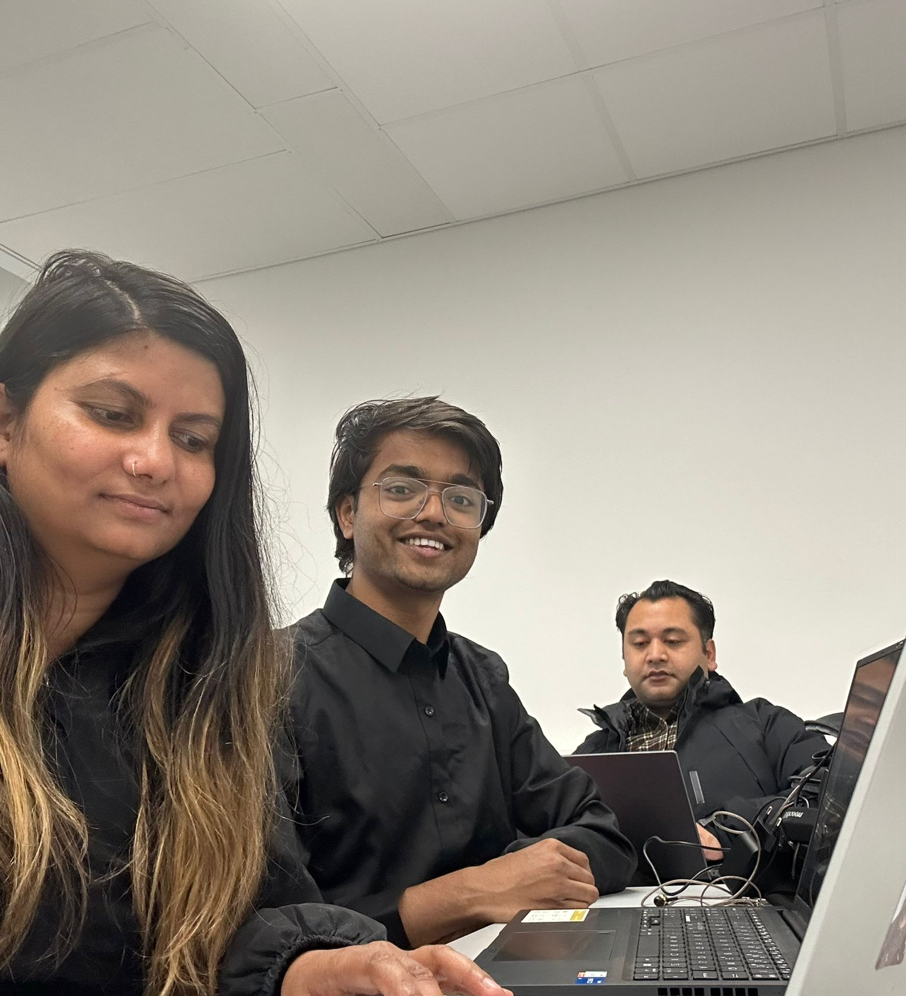
Thank You

